Slide 1
Legal aspects of privacy and HIPAA
Alla Topp
MSDS 620 – Data ethics

Slide 2

Introduction
Privacy issues arise in data science when we collect information on people and use it in various ways, such as optimizing websites, providing services, or advertising. It is also a growing concern for Americans, especially as the internet and technology have made personal information more accessible and easier to collect and manipulate. Due to problems in the past, many rules and regulations have been created to address privacy issues. We will look at the legal aspects of privacy and regulations to see how important privacy is and what issues we can face in privacy. Also, we are going to look at HIPAA regulations ad how they deal with privacy.

Slide 3

The legal aspects of privacy
the right to be let alone
the option to limit the access others have to one's personal information
secrecy, or the option to conceal any information from others
control over others' use of information about oneself
states of privacy
personhood and autonomy
self-identity and personal growth
protection of intimate relationships

Slide 4
The legal aspects of privacy
Right to be let alone
Limited access
Control over information
It has been interpreted to mean the right of a person to choose seclusion from the attention of others if they wish to do so, and the right to be immune from scrutiny or being observed in private settings, such as one's own home.
Limited access refers to a person's ability to participate in society without having other individuals and organizations collect information about them.
Control over one's personal information is the concept that "privacy is the claim of individuals, groups, or institutions to determine for themselves when, how, and to what extent information about them is communicated to others.

Slide 5
The legal aspects of privacy
States of privacy
Secrecy
Personhood and autonomy
Solitude is a physical separation from others. Intimacy is a "close, relaxed, and frank relationship between two or more individuals" that results from the seclusion of a pair or small group of individuals. Anonymity is the "desire of individuals for times of 'public privacy”.
In various legal contexts, when privacy is described as secrecy, a conclusion if privacy is secrecy then rights to privacy do not apply for any information which is already publicly disclosed.
Privacy may be viewed as a state that enables autonomy, a concept closely connected to that of personhood. An autonomous self-concept entails a conception of oneself as a "purposeful, self-determining, responsible agent" and an awareness of one's capacity to control the boundary between self and other.

Slide 6
Self-identity and personal growth
protection of intimate relationships
Privacy may be understood as a prerequisite for the development of a sense of self-identity. Privacy may be seen as a state that fosters personal growth, a process integral to the development of self-identity. without privacy—solitude, anonymity, and temporary releases from social roles—individuals would be unable to freely express themselves and to engage in self-discovery and self-criticism.
The intimacy theory imagines privacy to be an essential part of the way that humans have strengthened with other humans. Because part of human relationships includes individuals volunteering to self-disclose some information, but withholding other information, there is a concept of privacy as a part of the process by means of which humans establish relationships with each other.

Slide 7
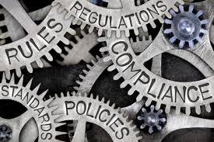
The Health Insurance Portability and Accountability Act (HIPAA)
HIPAA (Health Insurance Portability and Accountability Act of 1996) is United States legislation that provides data privacy and security provisions for safeguarding medical information.
The act, which was signed into law by President Bill Clinton on Aug. 21, 1996, contains five sections, or titles.
It was created primarily to modernize the flow of healthcare information, stipulate how Personally Identifiable Information maintained by the healthcare and healthcare insurance industries should be protected from fraud and theft, and address limitations on healthcare insurance coverage.

Slide 8
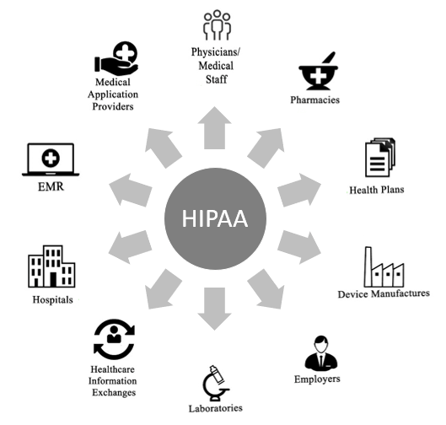
Additional facts about HIPAA
HIPAA has two main purposes: to provide continuous health insurance coverage for workers who lose or change their job, and to reduce the administrative burdens and cost of healthcare by standardizing the electronic transmission of administrative and financial transactions. Other goals include combating abuse, fraud and waste in health insurance and healthcare delivery and improving access to long-term care services and health insurance.

Slide 9
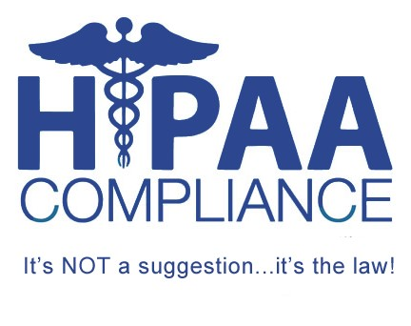
HIPAA compliance
The Health Insurance Portability and Accountability Act of 1996, commonly known as HIPAA, is a series of regulatory standards that outline the lawful use and disclosure of protected health information (PHI). HIPAA compliance is regulated by the Department of Health and Human Services (HHS) and enforced by the Office for Civil Rights (OCR).

Slide 10
What an organization must do to comply with the regulations
HIPAA Privacy Rule: The regulatory standards must be documented in the organization’s HIPAA Policies and Procedures. All employees must be trained on these Policies and Procedures annually, with documented attestation.
HIPAA Security Rule: Specifics of the regulation must be documented in the organization’s HIPAA Policies and Procedures. Staff must be trained on these Policies and Procedures annually, with documented attestation.

Slide 11
HIPAA Breach Notification Rule: The Rule differentiates between two kinds of breaches depending on the scope and size, called Minor Breaches and Meaningful Breaches. Organizations are required to report all breaches, regardless of size to HHS OCR, but the specific protocols for reporting change depending on the type of breach.
HIPAA Omnibus Rule: Business Associate Agreements are contracts that must be executed between a covered entity and business associate–or between two business associates–before ANY PHI or ePHI can be transferred or shared.
Notes:
The HIPAA Breach Notification Rule is a set of standards that covered entities and business associates must follow in the event of a data breach containing PHI or ePHI.

Slide 12
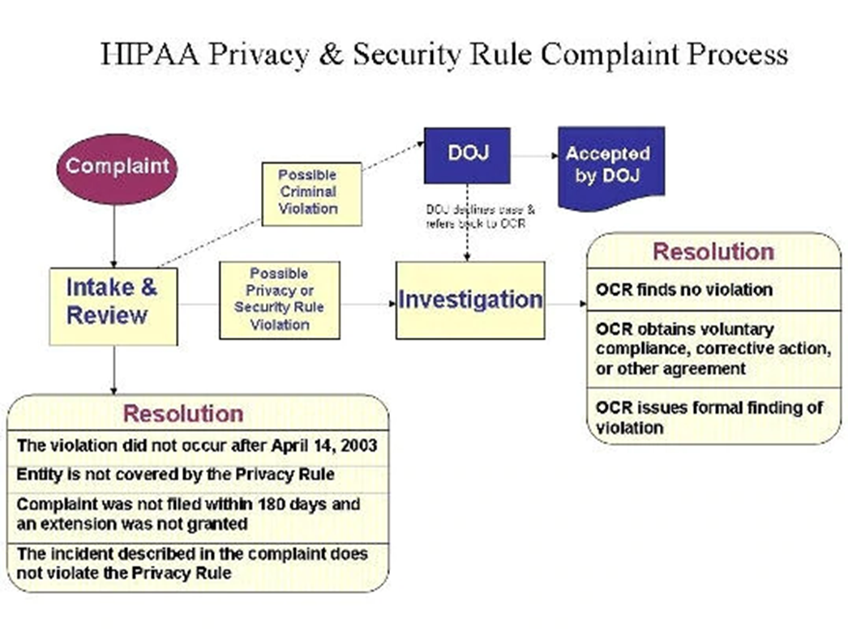

Slide 13

HIPPA enforcement
HHS’ Office for Civil Rights is responsible for enforcing the Privacy and Security Rules. Enforcement of the Privacy Rule began April 14, 2003 for most HIPAA covered entities.
OCR enforces the Privacy and Security Rules in several ways:
by investigating complaints filed with it,
conducting compliance reviews to determine if covered entities are in compliance, and
performing education and outreach to foster compliance with the Rules' requirements.
OCR also works in conjunction with the Department of Justice (DOJ) to refer possible criminal violations of HIPAA.

Slide 14

Summary
Without a doubt, we are living in a data-driven society. We are living in a world of globalizing economies, data transfer, and ubiquitous access to everything from everywhere. Living in our increasingly social world has and will continue to present a paradox with personal privacy: Information placed on the internet and available publicly can be used in unintended ways, regardless of your original intent. This is true for public sector organizations, businesses, and individuals alike. We need to make the privacy our priority and follow the regulations at work, on the internet and in daily life.

Slide 15

References
4 Aspects of Data Privacy We Must Address. (2015, March 16). Retrieved from https://www.avepoint.com/blog/protect/global-privacy-summit-2015-takeaways/
HHS Office of the Secretary,Office for Civil Rights, & Ocr. (2017, July 25). HIPAA Compliance and Enforcement. Retrieved from https://www.hhs.gov/hipaa/for-professionals/compliance-enforcement/index.html
Privacy. (2019, May 18). Retrieved from https://en.wikipedia.org/wiki/Privacy
Sivilli, F. (2019, May 03). What is HIPAA Compliance? | HIPAA Requirements. Retrieved from https://compliancy-group.com/what-is-hipaa-compliance/
What is HIPAA (Health Insurance Portability and Accountability Act) ? - Definition from WhatIs.com. (n.d.). Retrieved from https://searchhealthit.techtarget.com/definition/HIPAA

Slide 16

Thank you!

